Slide 1
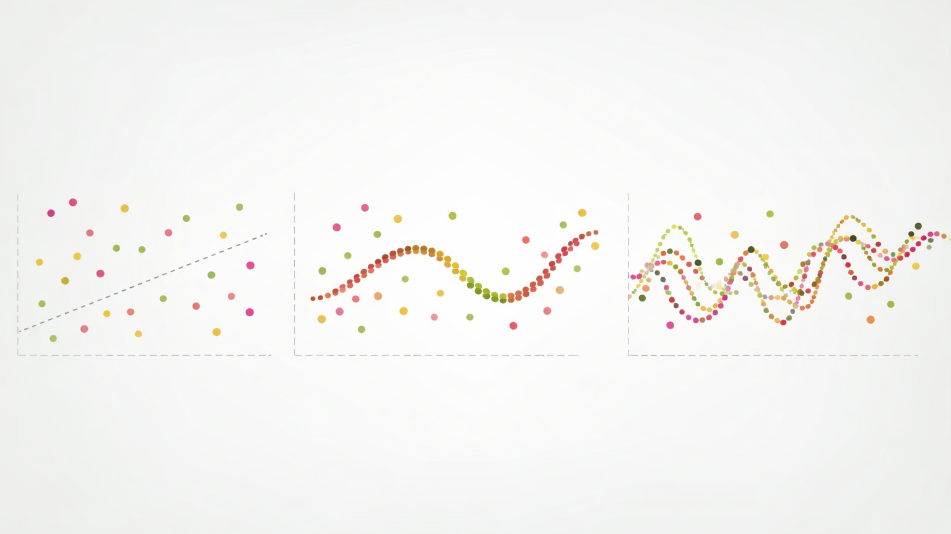
Model fitting

Slide 2
Over- and under-fitting

Slide 3
Overfitting vs Underfitting
Underfitting: Model is too simple to learn the underlying structure of the data
Overfitting: Model is too complex and learns the noise in the training data

Slide 4
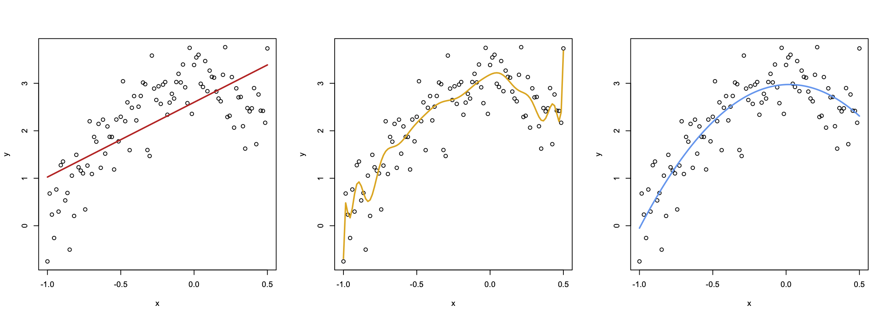
Overfitting vs Underfitting
Underfit Model
Overfit Model
Good Model

Slide 5
Underfitting
Underfitting: Model is too simple to learn the underlying structure of the data
Identifying: The model performs poorly on both training and test data
Possible fixes:
Use a more complex model
Find better features
Reduce constraints on model (less regularization)
Tune hyperparameters

Slide 6
Overfitting
Overfitting: Model is too complex and learns the noise in the training data
Identifying: The model performs well on training data but poorly on test data
Possible fixes:
Use a simpler model
Add constraints on model (more regularization)
Gather more data
Tune hyperparameters

Slide 7
Bias-Variance Tradeoff
The balance of finding a model that doesn’t underfit or overfit is related to the bias-variance tradeoff
Bias of refers to the error that is introduced by approximating a real-life problem with a simpler model
Variance refers to the amount that the prediction changes if a different training set is used (but from the same “population”)
In general, as a model becomes more flexible and complex, variance increases and bias decreases
Overfitting is associated with high variance
Underfitting is associated with high bias

Slide 8
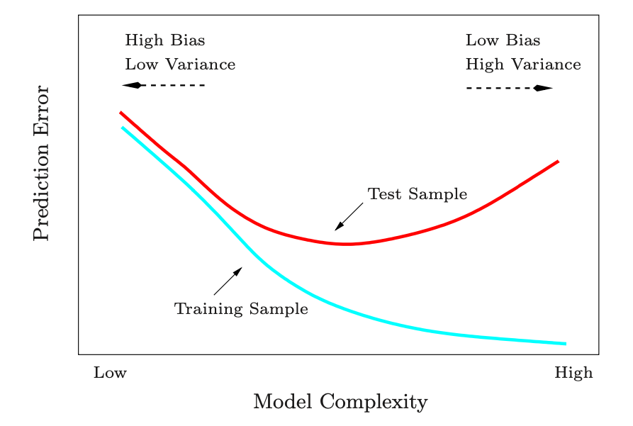
Bias-Variance Tradeoff
From “Elements of Statistical Learning” page 38, by Hastie et al

Slide 9
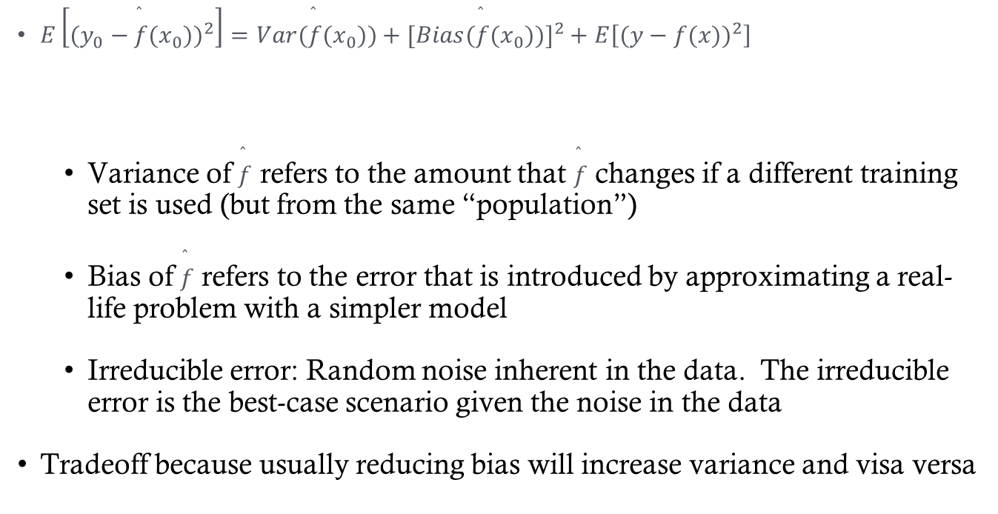
Bias-Variance Tradeoff
$E\left[(y_{0}−\overset{̂}{f}(x_{0}))^{2}\right]=Var(\overset{̂}{f}(x_{0}))+[Bias(\overset{̂}{f}(x_{0}))]^{2}+E\left[(y−f(x))^{2}\right]$
Variance of $\overset{̂}{f}$ refers to the amount that $\overset{̂}{f}$ changes if a different training set is used (but from the same “population”)
Bias of $\overset{̂}{f}$ refers to the error that is introduced by approximating a real-life problem with a simpler model
Irreducible error: Random noise inherent in the data. The irreducible error is the best-case scenario given the noise in the data
Tradeoff because usually reducing bias will increase variance and visa versa
Variance
Bias (squared)
Irreducible error

Slide 10
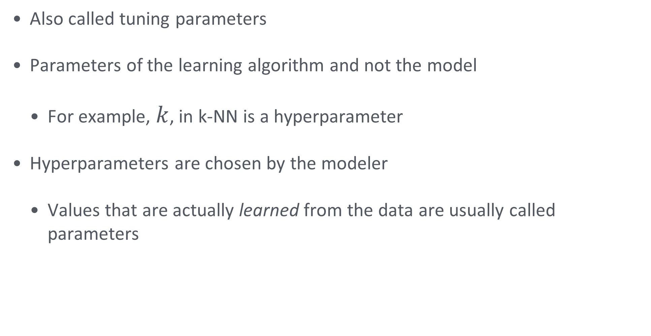
Hyperparameters
Also called tuning parameters
Parameters of the learning algorithm and not the model
For example, $k$, in k-NN is a hyperparameter
Hyperparameters are chosen by the modeler
Values that are actually learned from the data are usually called parameters

Slide 11
K-nn recall
Recall what we learned about KNN classification and regression
Will a low value of k be more likely to overfit or underfit?
Will a high value of k be more likely to overfit or underfit?

Slide 12
Testing and Validating

Slide 13
How well does my model work?
In the prediction setting:
Model evaluation: how well does our machine learning model generalize to new data?
Don’t get caught in the weeds of the possible validation methods
Find an honest metric to quantify future model performance

Slide 14
How well does my model work?
The only way to evaluate how well a model predicts is to apply it to new data
Comparing test metrics to training metrics can also help identify overfitting
What if new data (with labels) isn’t readily available (and it usually isn’t)

Slide 15
Model Evaluation Strategies
Train/Test split
Train/Validation/Test split
Cross-validation

Slide 16
K-fold cross-validation

Slide 17
Choosing k (the number of folds)
The data scientist has yet another choice to make: k
k=n is leave-one-out cross-validation (LOOCV), this is deterministic
k=5 or k=10 are other popular choices
Bias–variance tradeoff in 𝑘k-fold CV:
Small k → higher bias but lower variance (larger test sets, more stable estimates).
Large k → lower bias but higher variance (larger training sets, noisier fold estimates).
When CV is used for tuning, bias is less important than just finding the minimum error
Computational cost:
Cost scales with k: small k is faster, while large k (especially LOOCV) is much more expensive.

Slide 18
A typical approach
Split data into training and test sets
Train the model several times using different values of the hyperparameter
Choose the hyperparameter value that performs best on the training set as measured with k-fold cross-validation
Use the test set to compute the generalization error
Remember that the goal is to get a good estimate of the generalization error

Slide 19
A tempting approach…
Split data into a training and a test set
Train the model for many hyperparameter values
Choose the hyperparameter value that performs best on test set
Beware of data leakage!!

